Slide 1
Digital Portfolio
STUDENT NAME: iyappan.S
REGISTER NO AND NMID: asbru172422k0265
DEPARTMENT: B.sc (cs)
COLLEGE: Sri vasavi college self finance wings BharathiyaBarathiyar university

Slide 2
PROJECT TITLE
My Bio Data

Slide 3


AGENDA
Problem Statement
Project Overview
End Users
Tools and Technologies
Portfolio design and Layout
Features and Functionality
Results and Screenshots
Conclusion
Github Link
3/21/2024 Annual Review

Slide 4
PROBLEM STATEMENT
"Nowadays, students and professionals often face difficulties in presenting their biodata in a clear and attractive way. Traditional paper biodata or resumes are limited, easily misplaced, and do not highlight skills interactively. A biodata website solves this problem by providing a digital platform to showcase personal information, education, skills, and achievements in an organized and accessible manner. It allows others, such as employers, teachers, or friends, to easily view and understand a person’s background anytime and anywhere."

Slide 5

PROJECT OVERVIEW
Creating Web page in digital portfolio to bio data.Using the language HTML CSS JavaScript .

Slide 6

WHO ARE THE END USERS?
All the user and humans are the end user.

Slide 7

TOOLS AND TECHNIQUES
Digital portfolio
visual basic stdio
Code pee
HTML
CSS
Javascript

Slide 8
POTFOLIO DESIGN AND LAYOUT
8

Slide 9
FEATURES AND FUNCTIONALITY
Features of Biodata Website
User-friendly Interface – Simple and clean design for easy navigation.
Personal Information Section – Displays name, photo, contact details, etc.Features of Biodata Website
Facilities of Biodata Website
Provides a digital platform for presenting biodata.
Accessible anytime, anywhere via the internet.

Slide 10
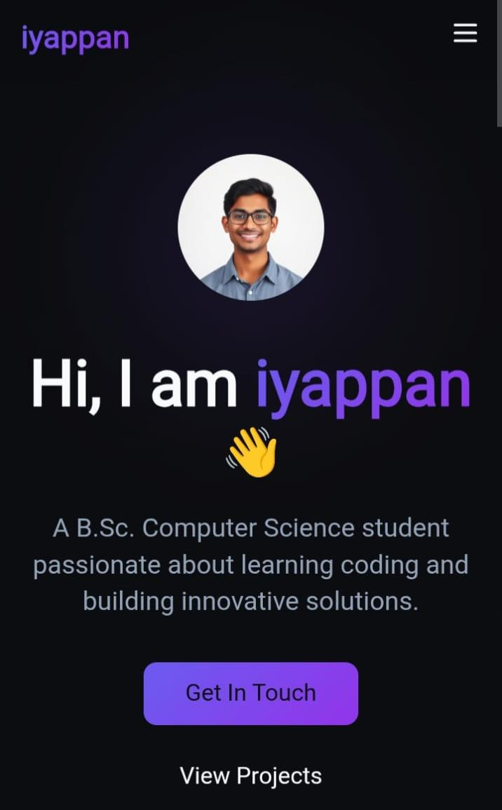

RESULTS AND SCREENSHOTS
3/21/2024 Annual Review
10

Slide 11
CONCLUSION
In conclusion, the biodata website provides a simple and effective platform to present personal, educational, and professional details in a well-organized manner. It eliminates the limitations of traditional paper resumes and makes information easily accessible anywhere, anytime. By showcasing skills, achievements, and contact details digitally, the website not only improves self-presentation but also creates a professional online presence for future opportunities.
11

